Slide 1
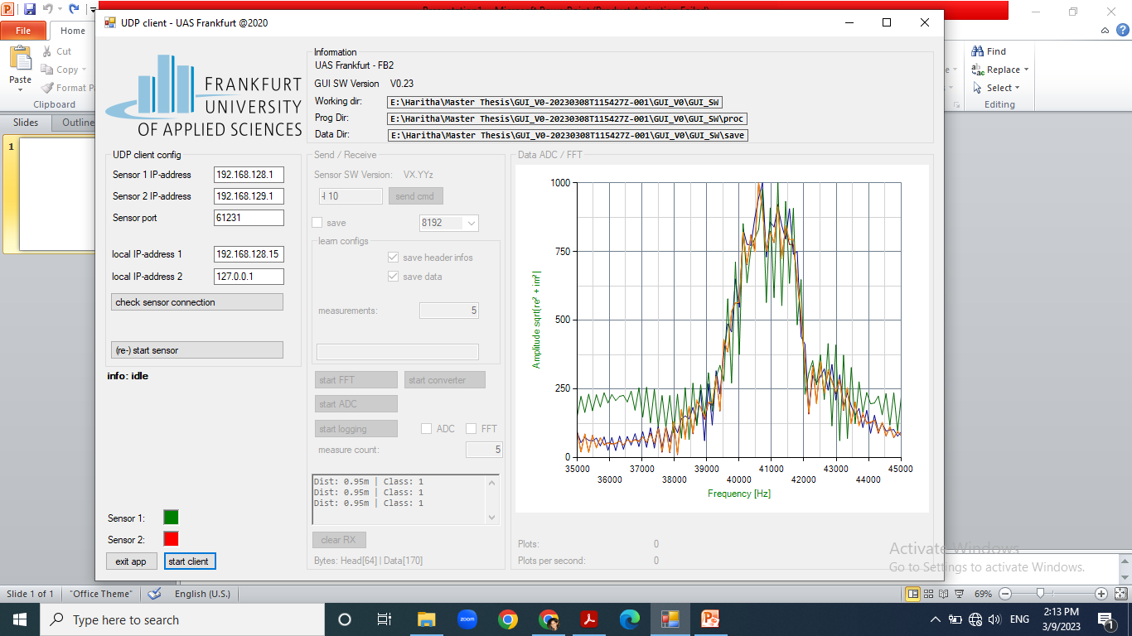

Slide 2
Notes:
Without baby

Slide 3
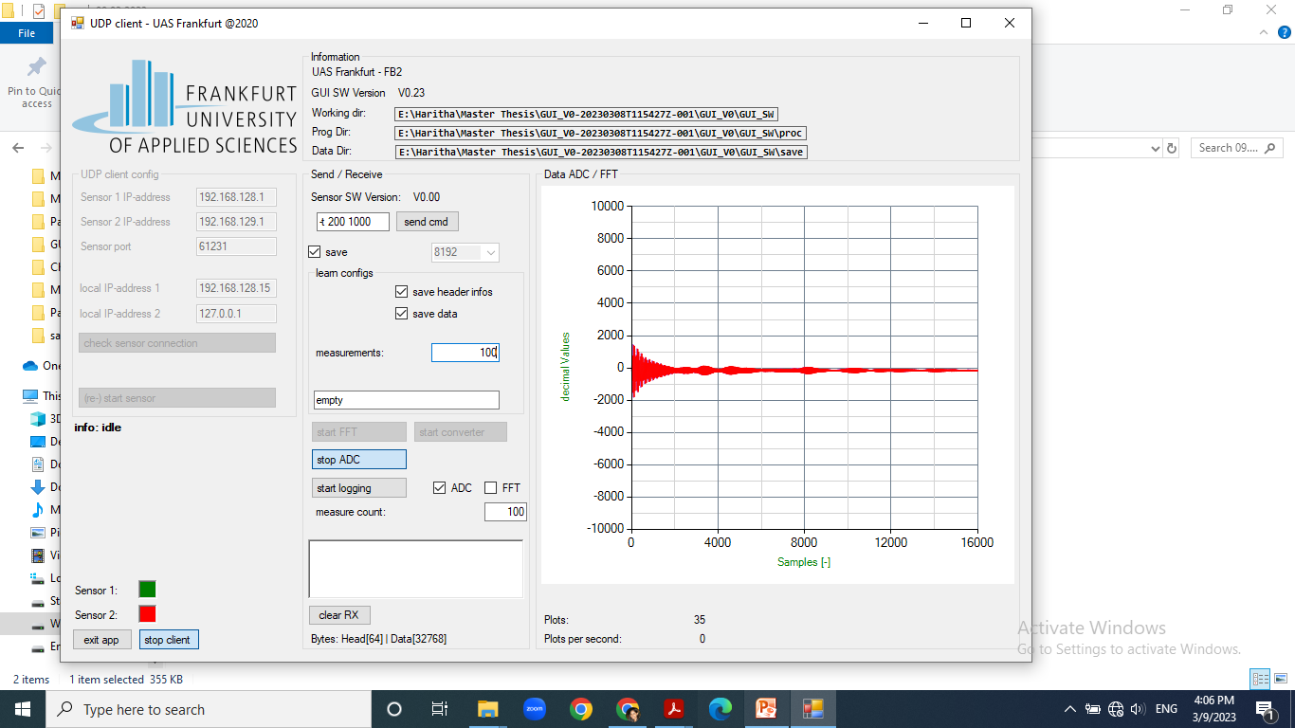
Notes:
Without baby

Slide 4
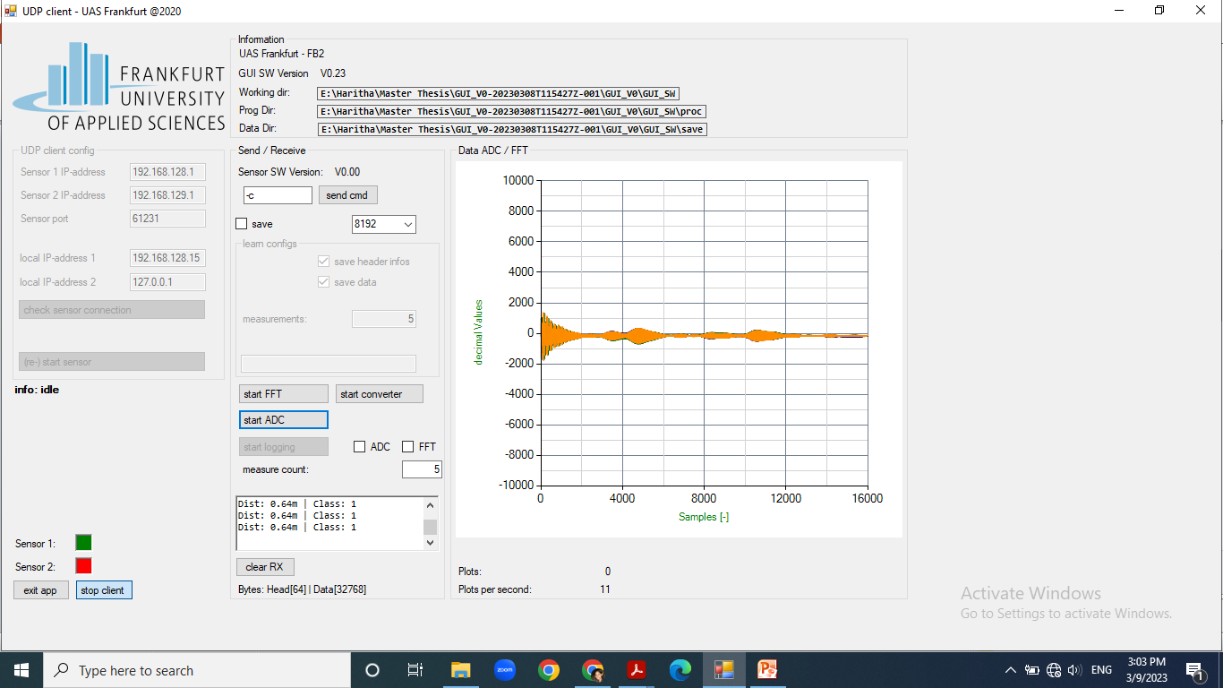
Notes:
With baby

Slide 5
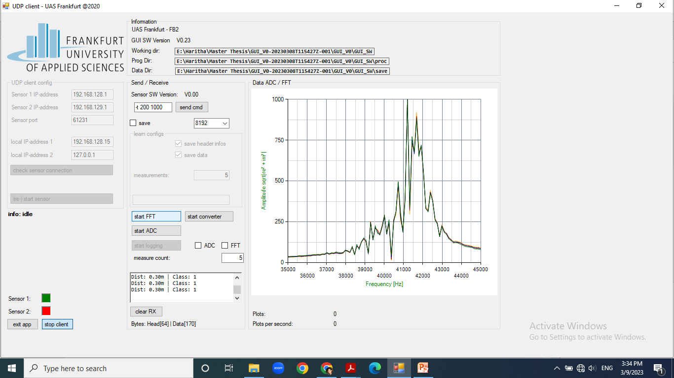
Notes:
Without baby

Slide 6
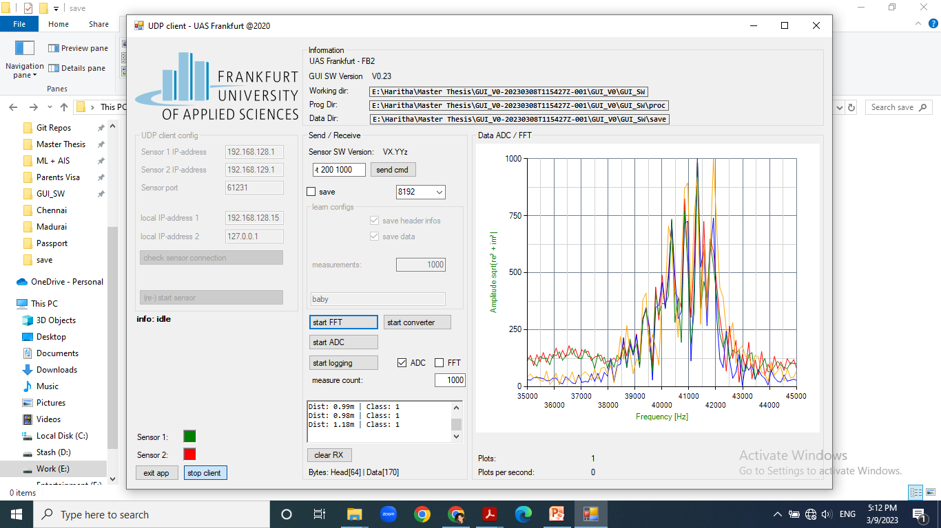
Notes:
empty

Slide 7
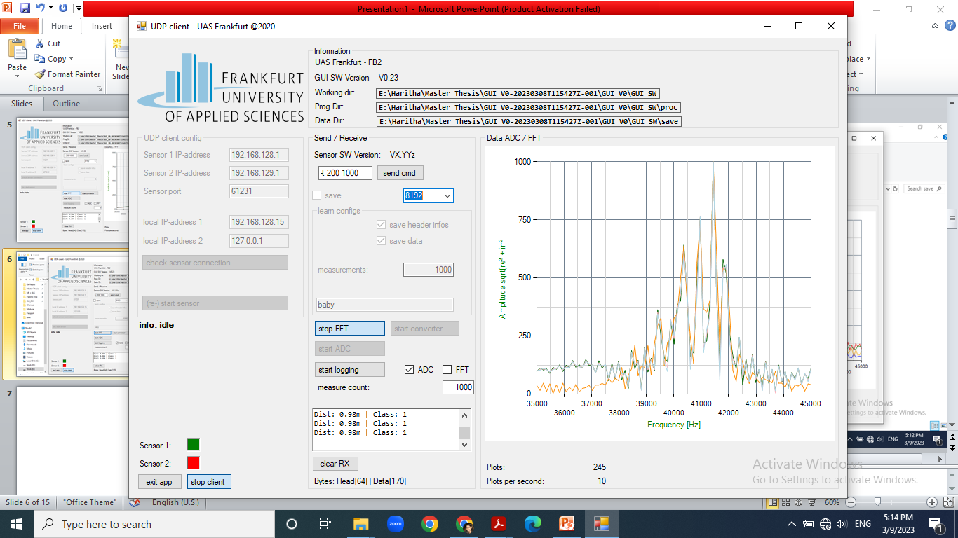
Notes:
baby

Slide 8
OUTSIDE SETUP WITH SENSOR RP 05

Slide 9
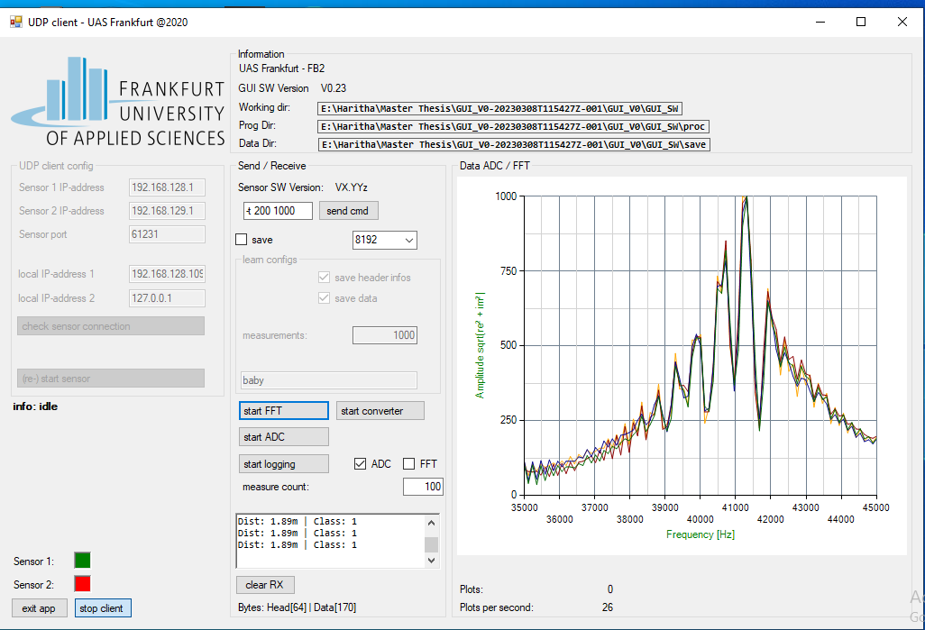
Notes:
With baby

Slide 10
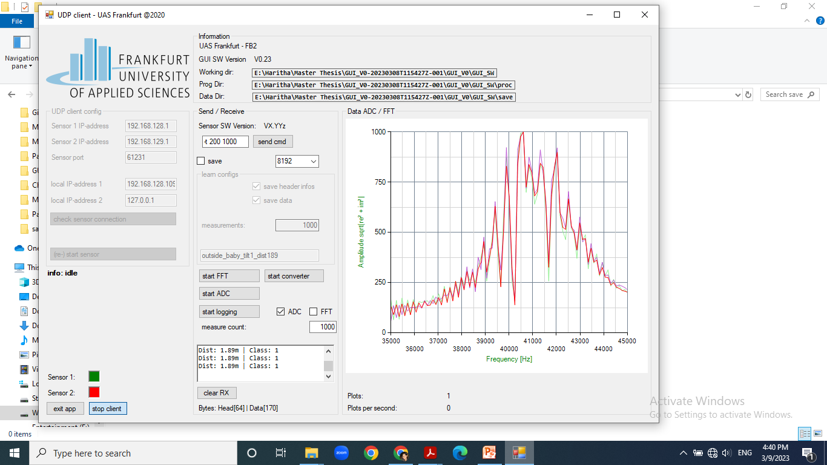
Notes:
baby

Slide 11
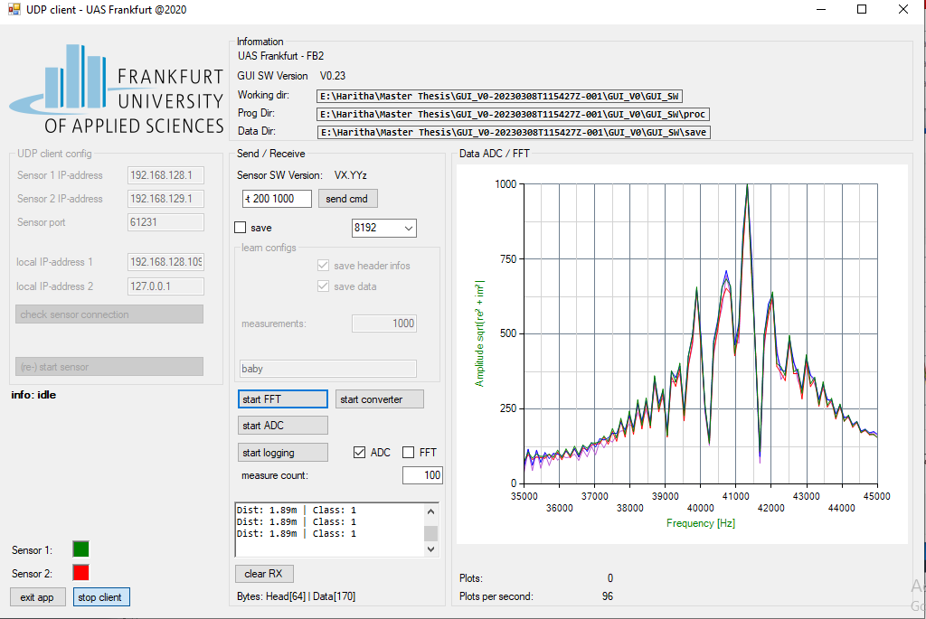
Notes:
Empty

Slide 12
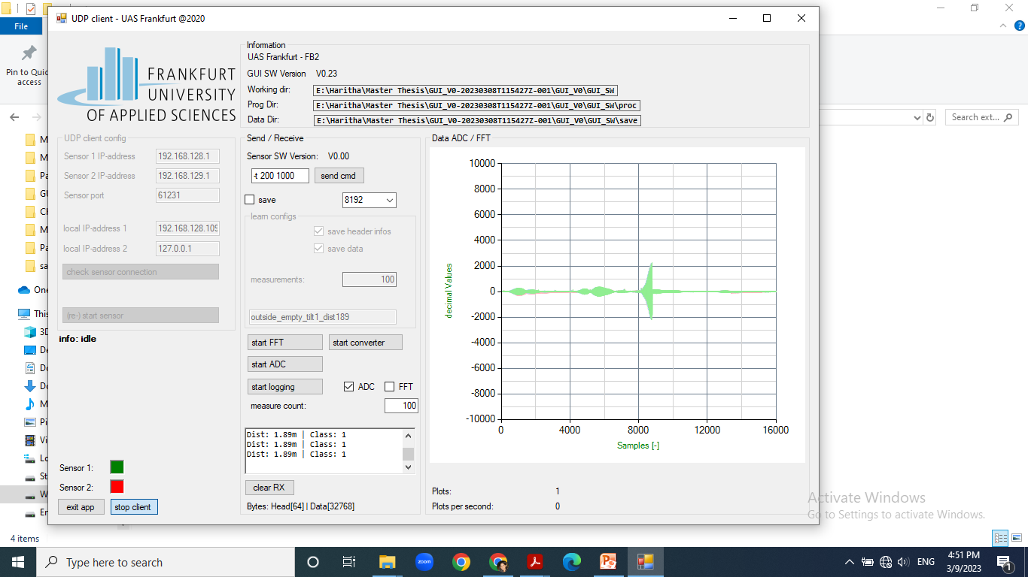
Notes:
Empty

Slide 13
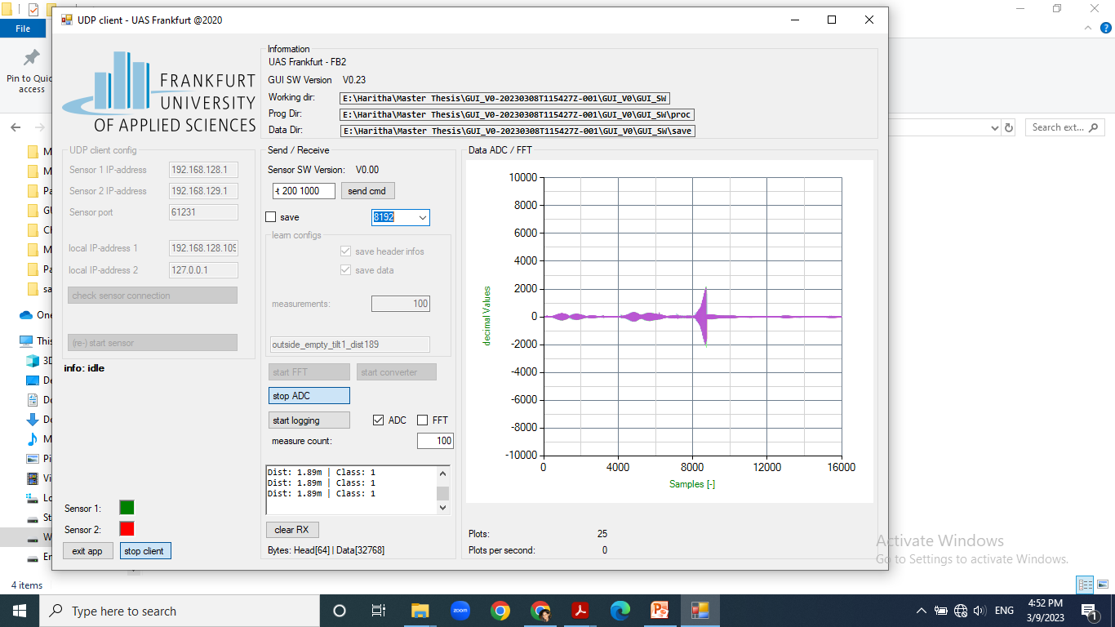
Notes:
baby

Slide 14
2nd DAY – 15.03.2023
Inside sensor

Slide 15
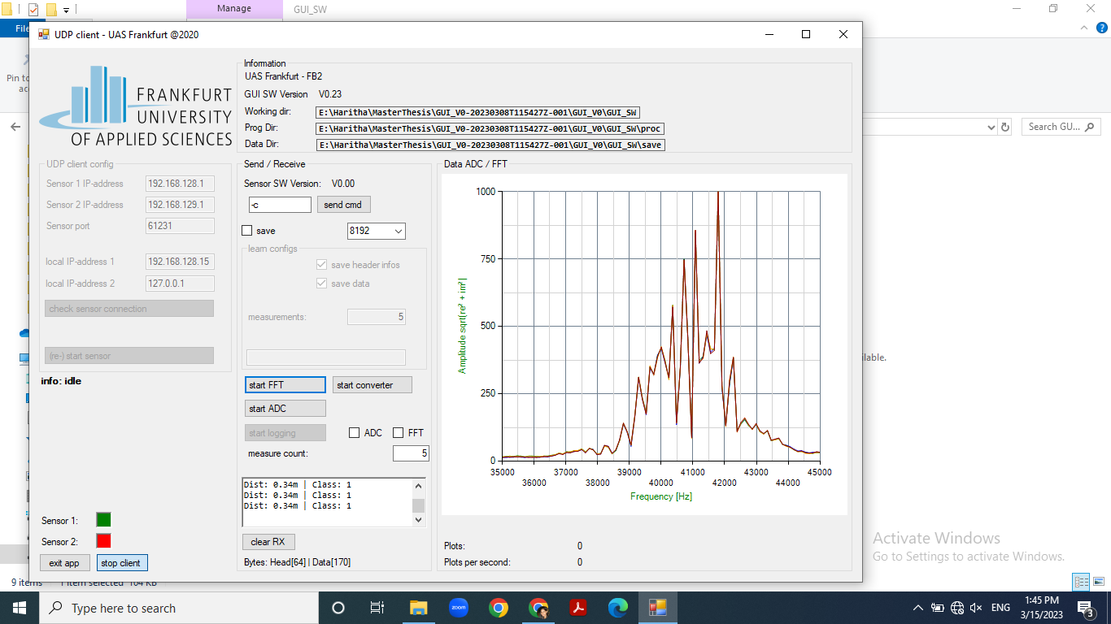
Notes:
BABY

Slide 16
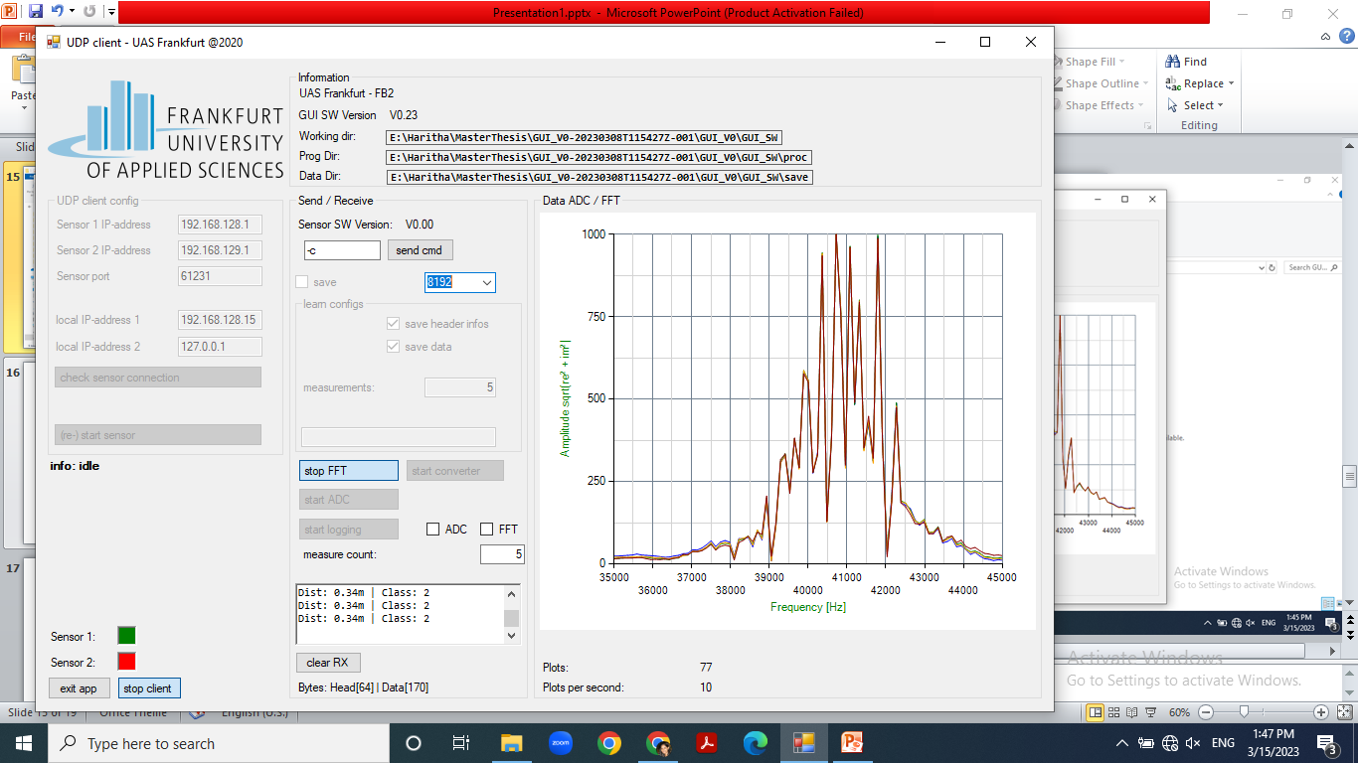
Notes:
EMPTY

Slide 17
24.03.2023
Notes:
For this date, baby_1 in fft and adc readings looked like they were false

Slide 18
Internal Sensor – RP 19

Slide 19
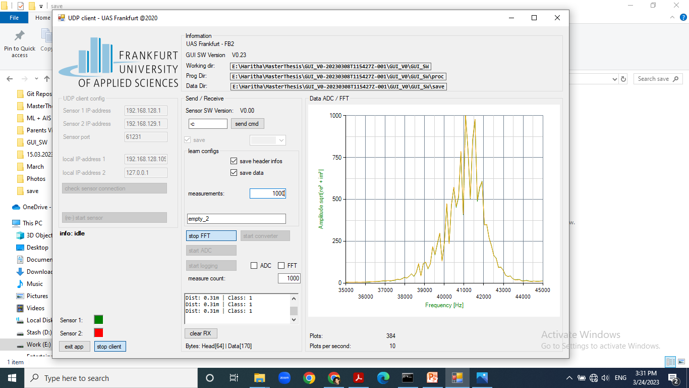
Notes:
empty

Slide 20
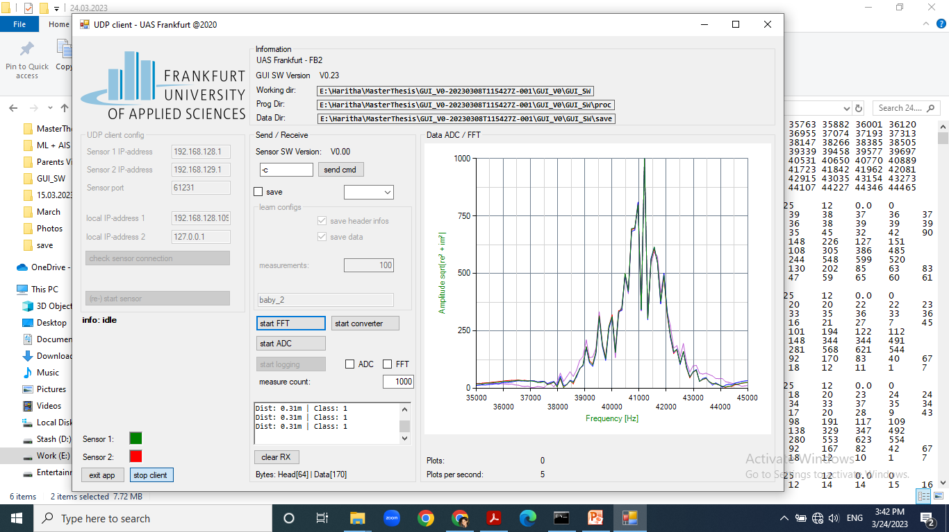
Notes:
baby

Slide 21
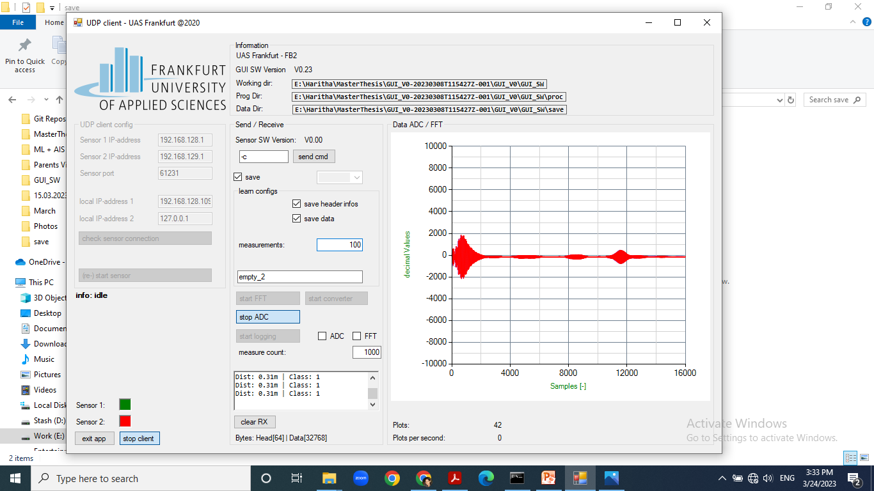
Notes:
empty

Slide 22
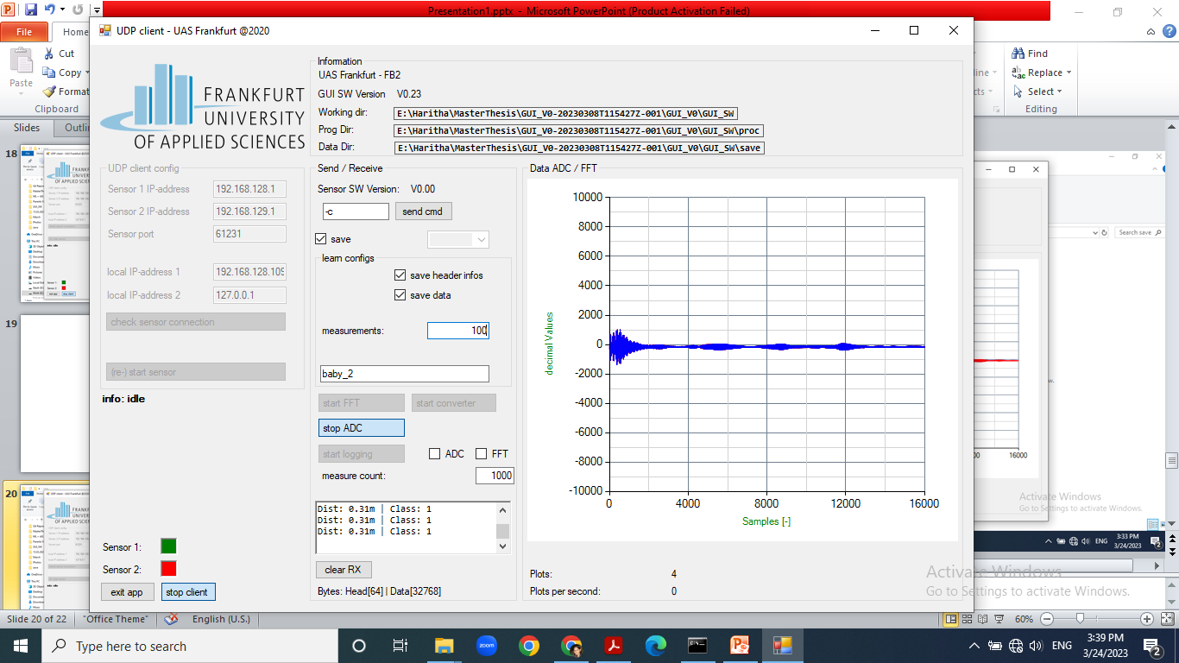
Notes:
baby

Slide 23
13.04.2023

Slide 24
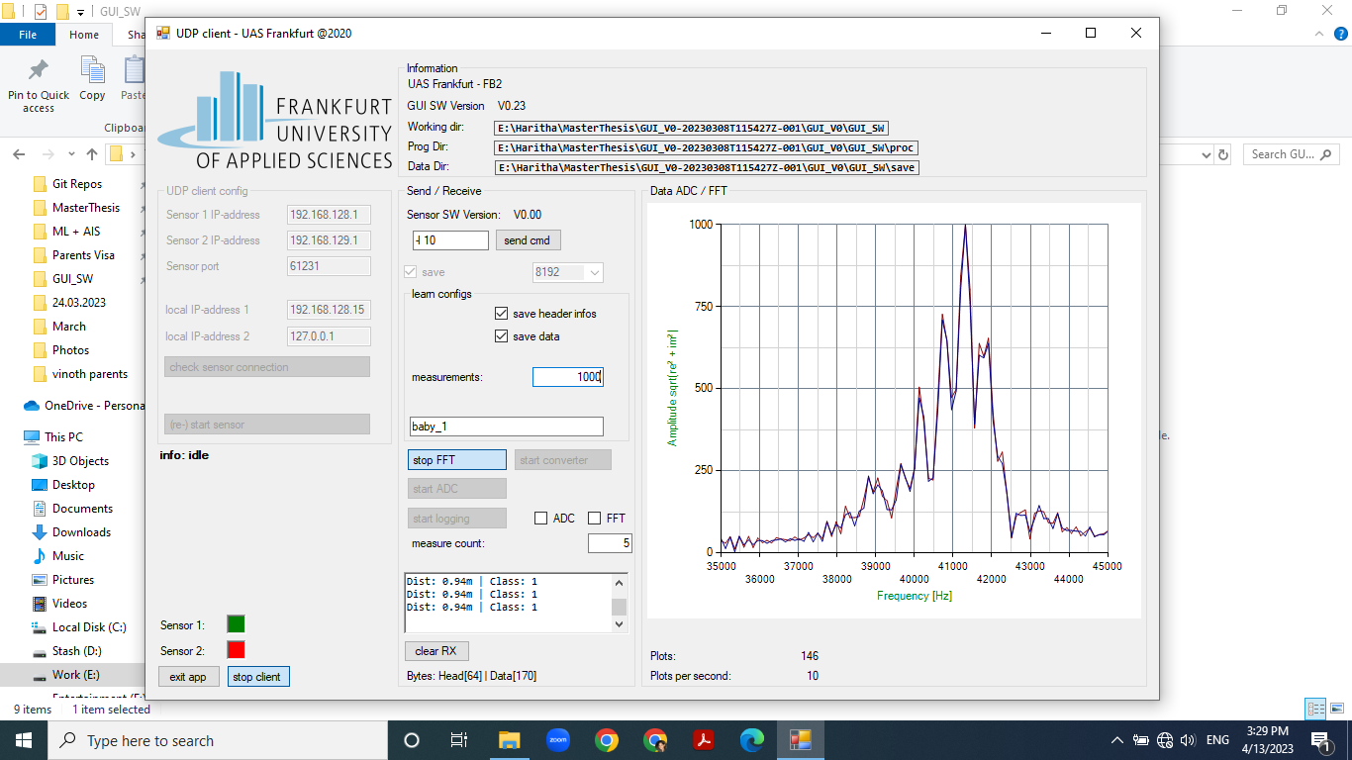
Notes:
Baby – seat in middle position, maybe the branch like featureat 41500-42000 hz is the feet of baby

Slide 25
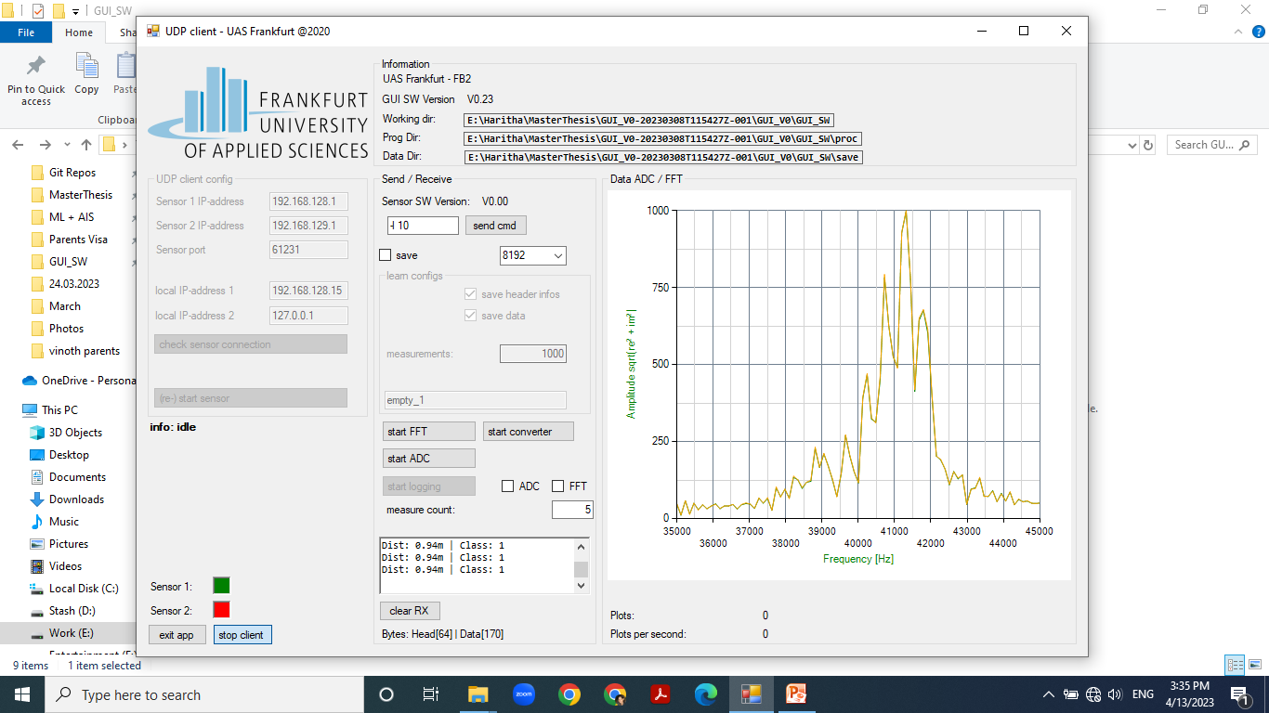
Notes:
Empty seat in middle position

Slide 26
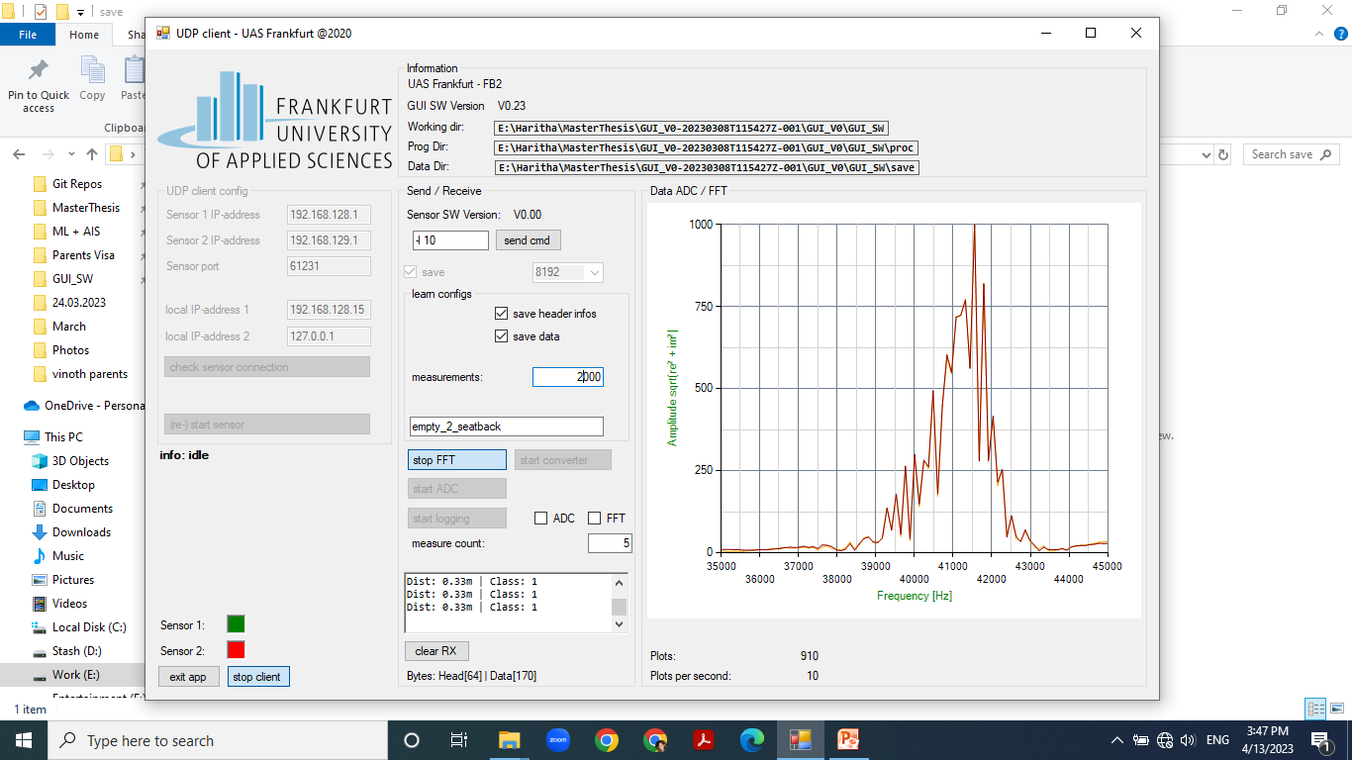
Notes:
Empty – seat in backmost position

Slide 27
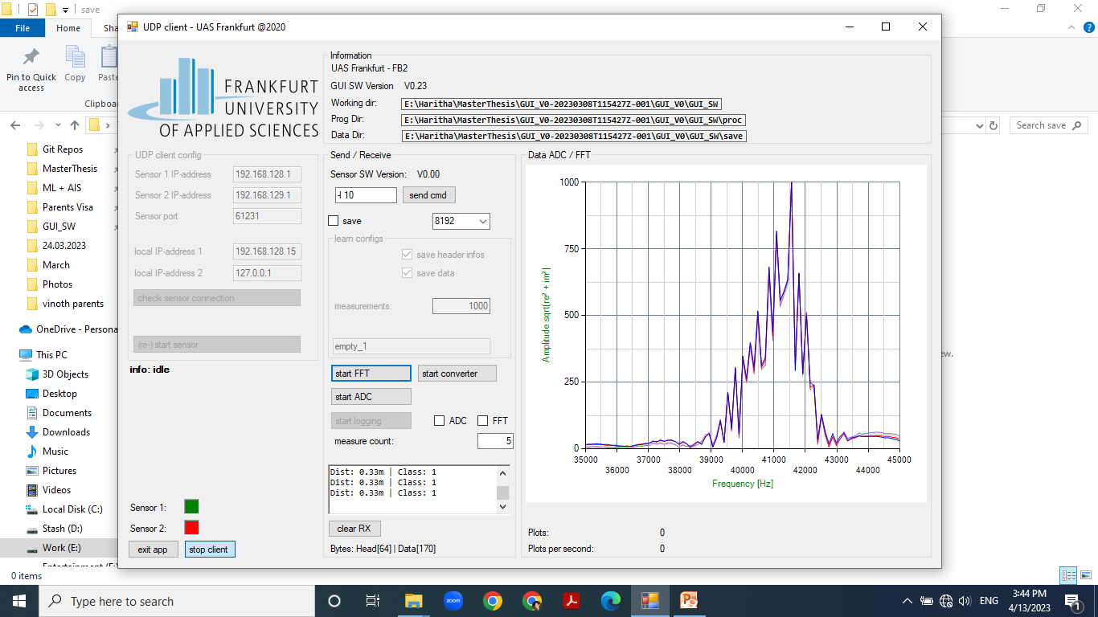
Notes:
Baby – seat in backmost position

Slide 28
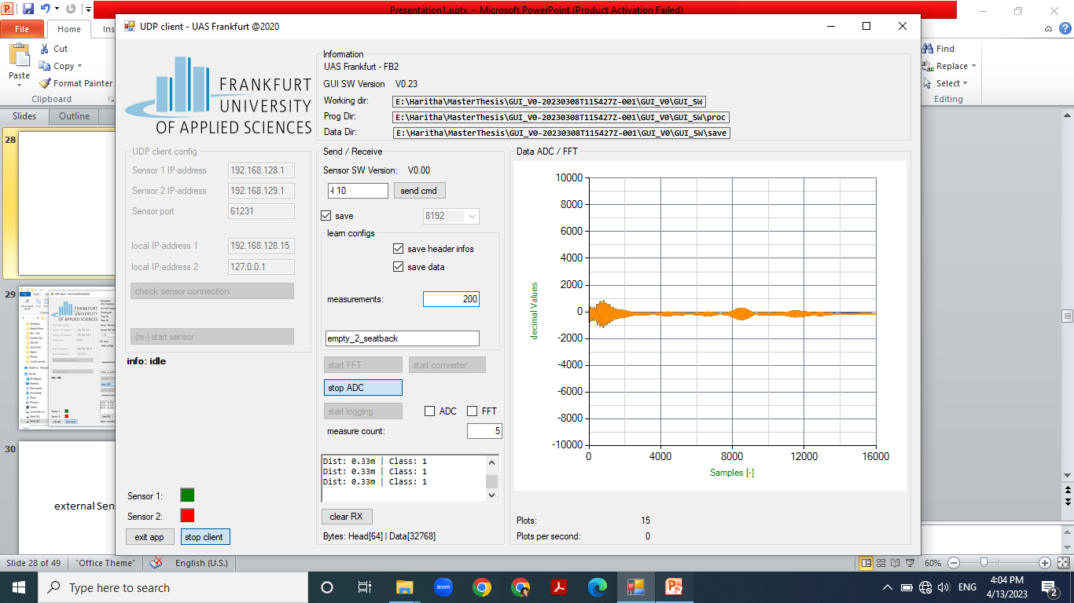
Notes:
Empty - seatback

Slide 29
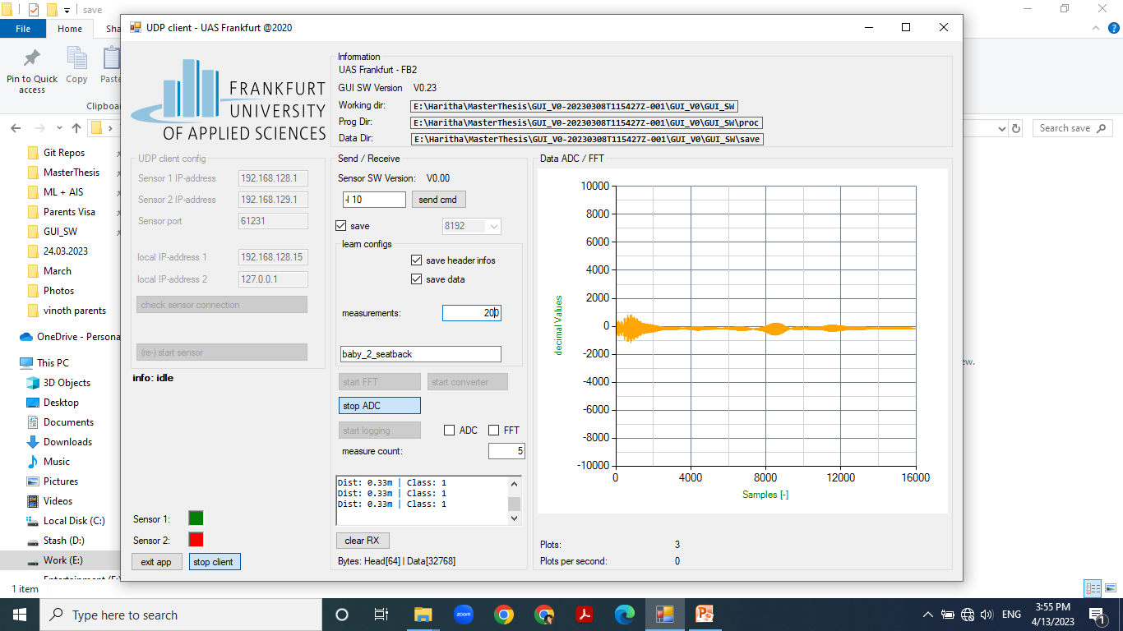
Notes:
Baby – seatback

Slide 30
21.04.2023
Seat upright position, distance from sensor = backmost,
All belts attached according to instruction diagram.

Slide 31
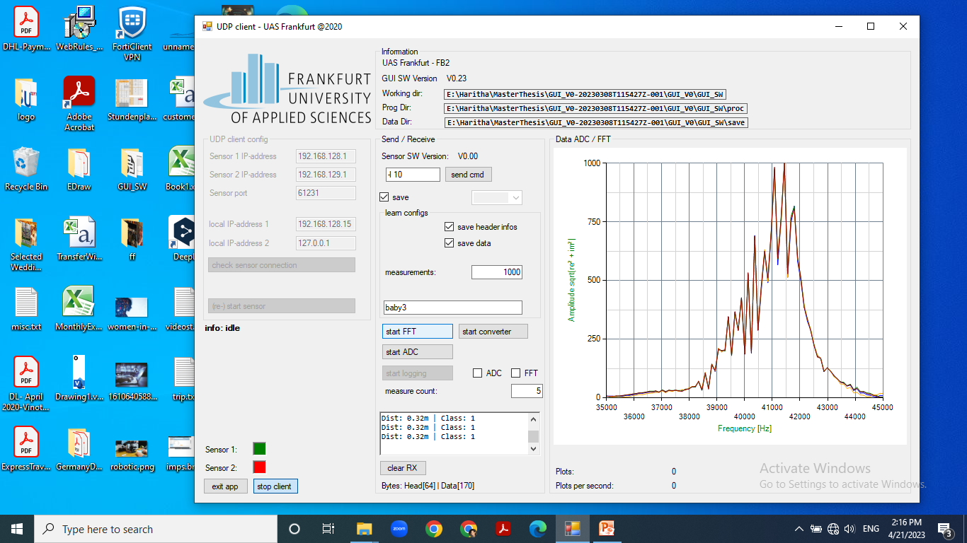
Notes:
baby

Slide 32
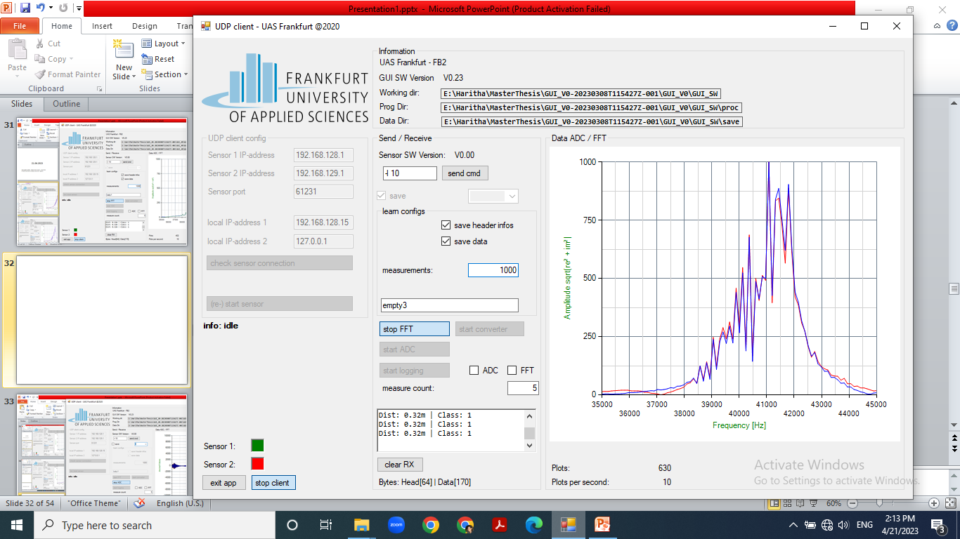
Notes:
empty

Slide 33
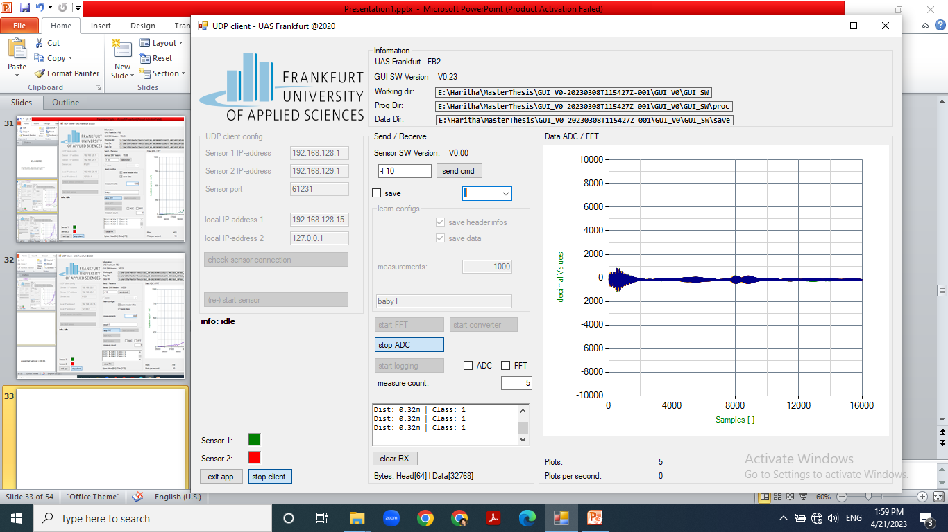

Slide 34

Notes:
empty

Slide 35
25.04.2023

Slide 36
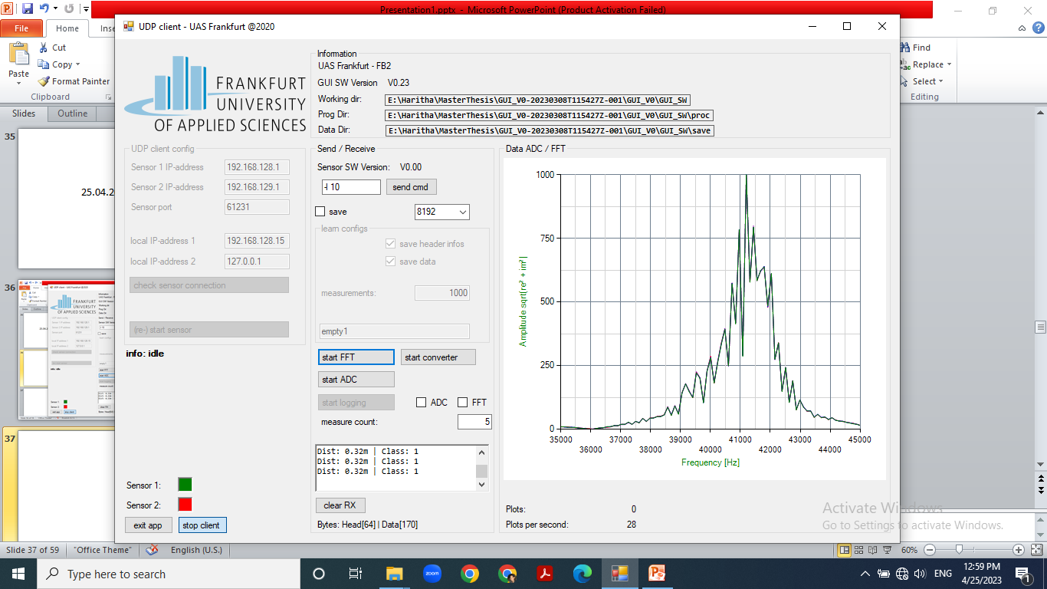
Notes:
empty

Slide 37
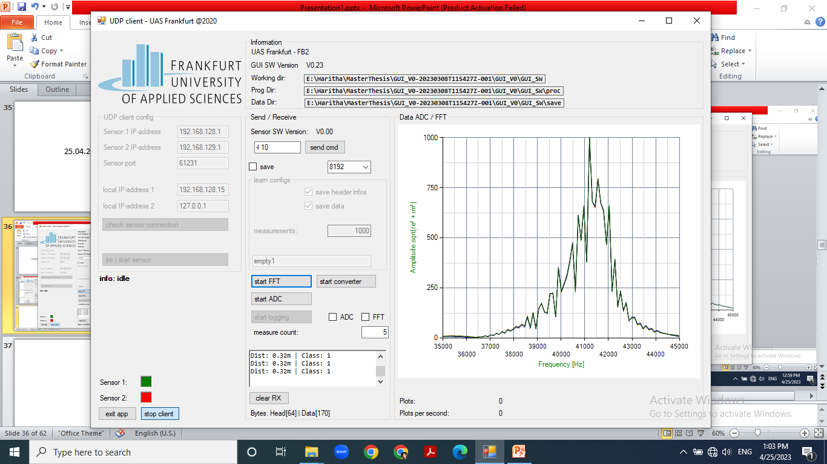
Notes:
Baby, noted that baby strap when left on top of seat also creates a second peak just like mimicking the baby in an empty seat. Condition to watch out for false positives

Slide 38
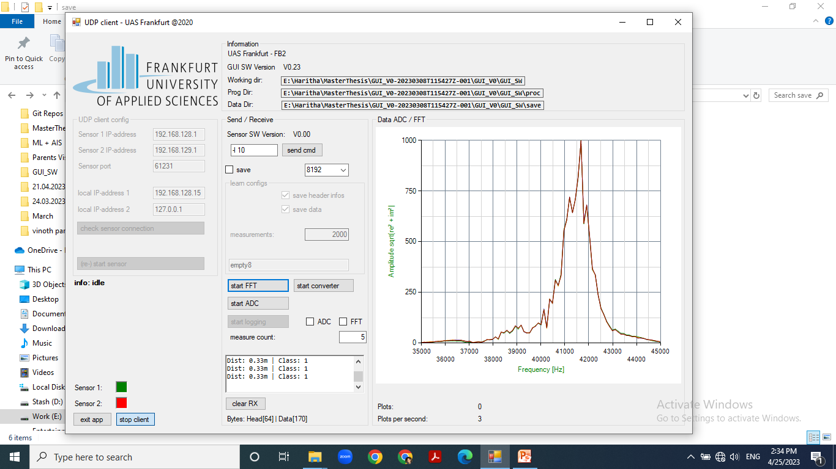
Notes:
Baby, with sunshade opened

Slide 39
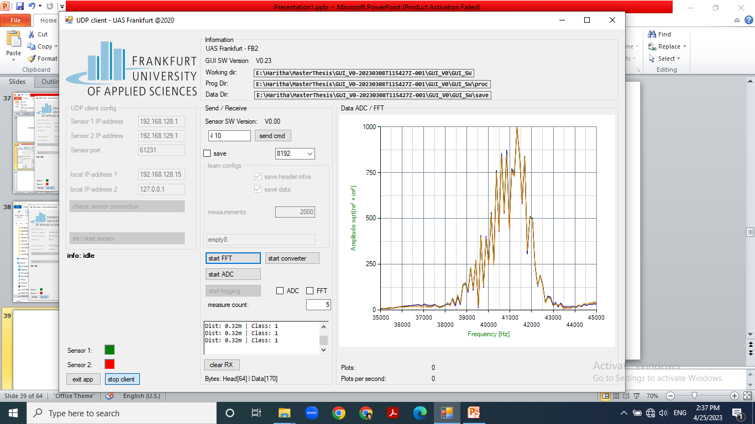
Notes:
Baby without sunshade

Slide 40
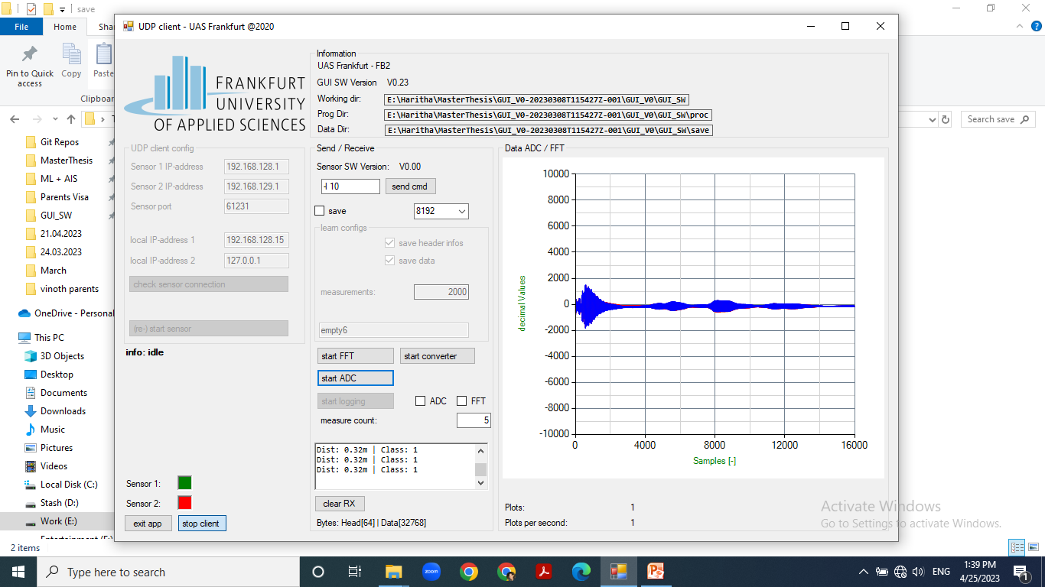
Notes:
empty

Slide 41
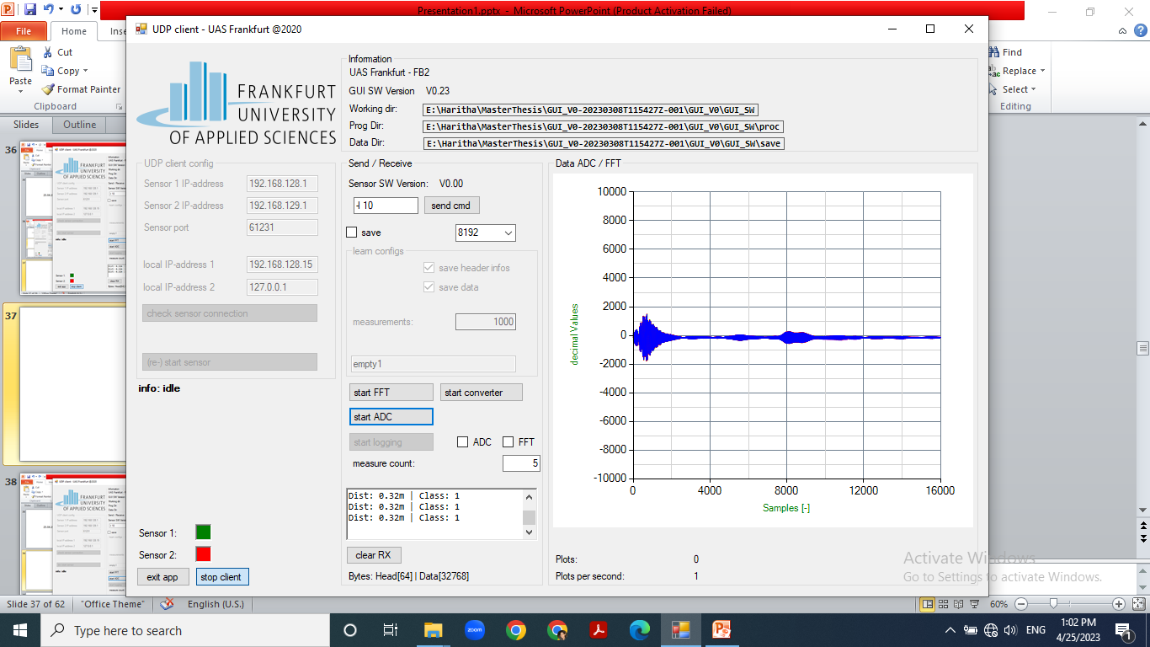
Notes:
baby

Slide 42
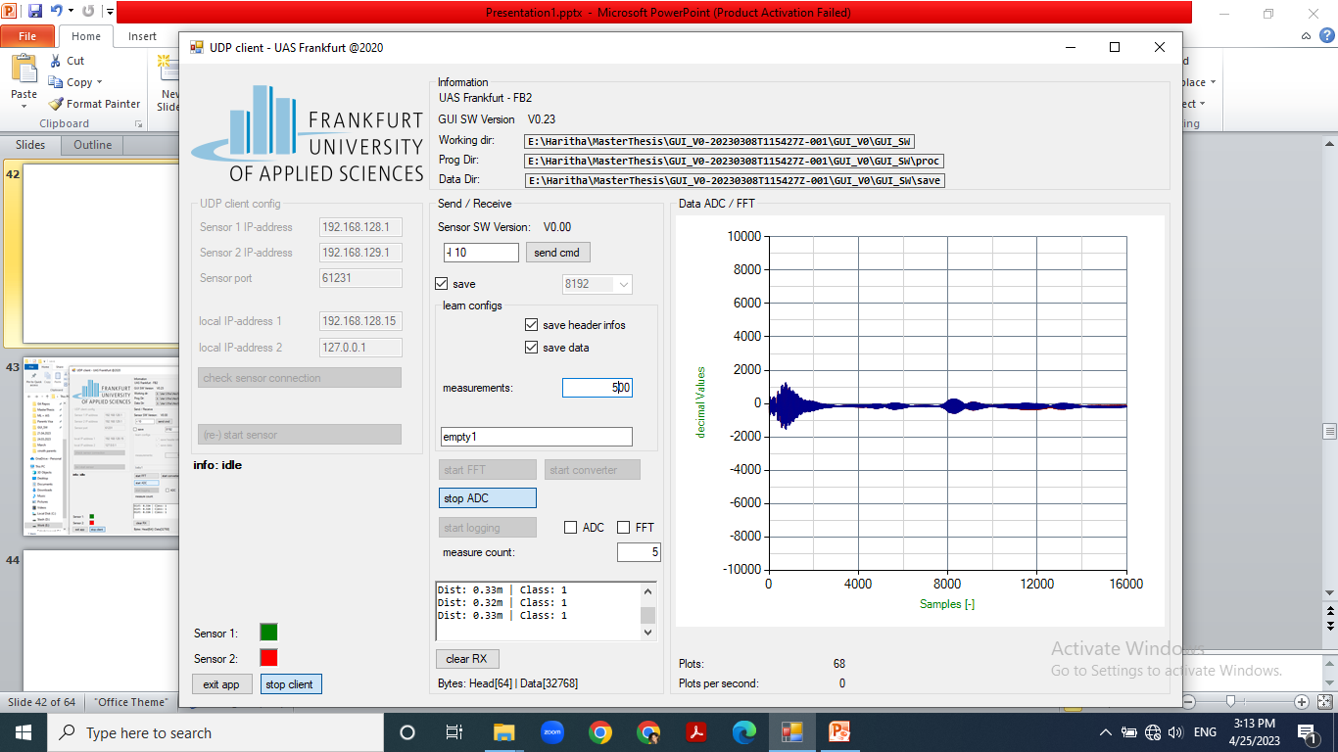
Notes:
empty

Slide 43
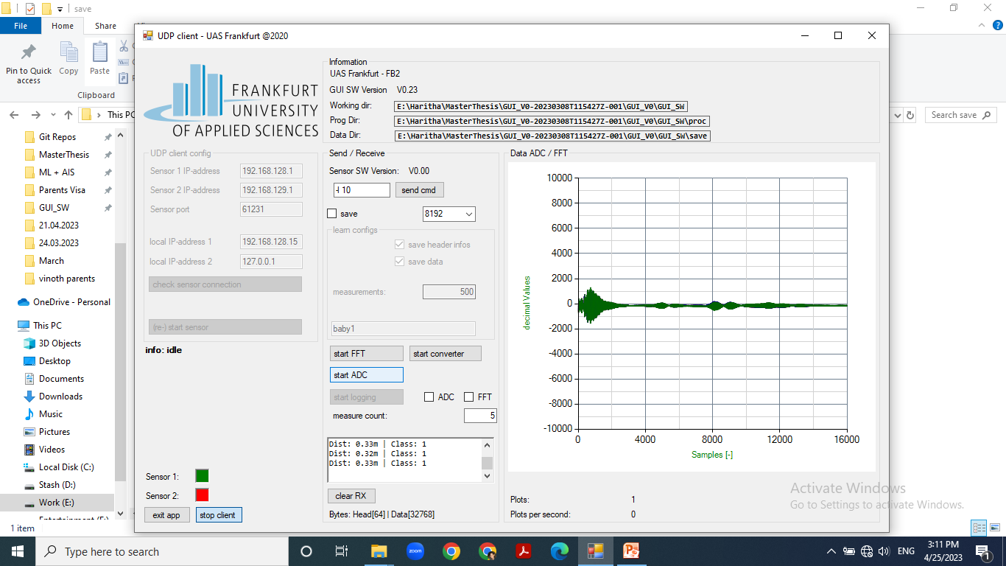
Notes:
baby

Slide 44
27.04.2023

Slide 45
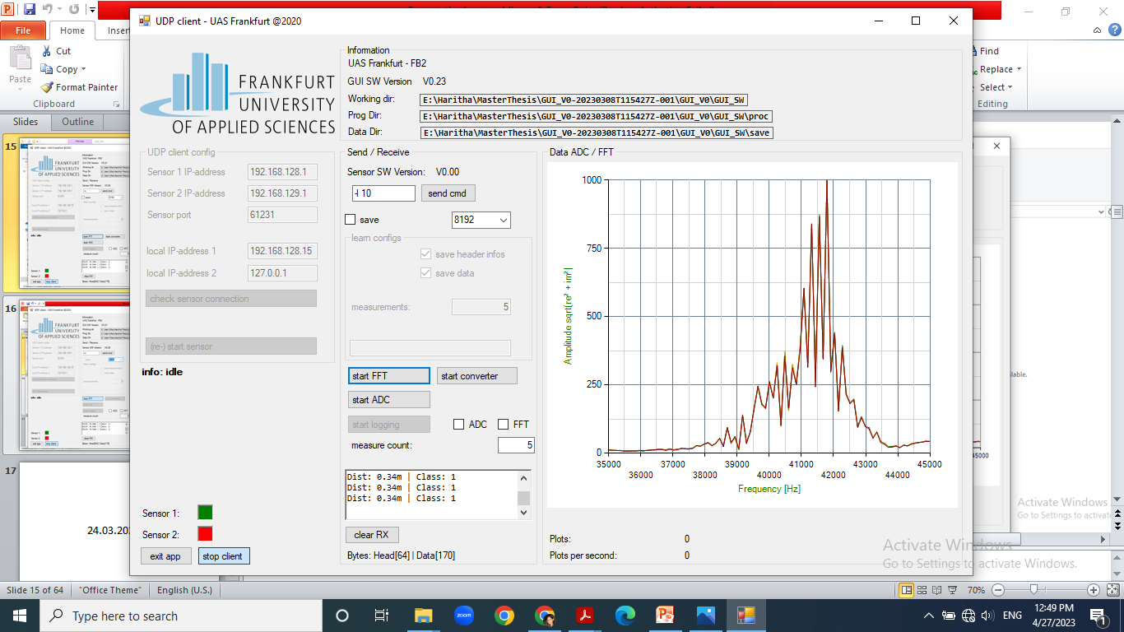
Notes:
baby

Slide 46
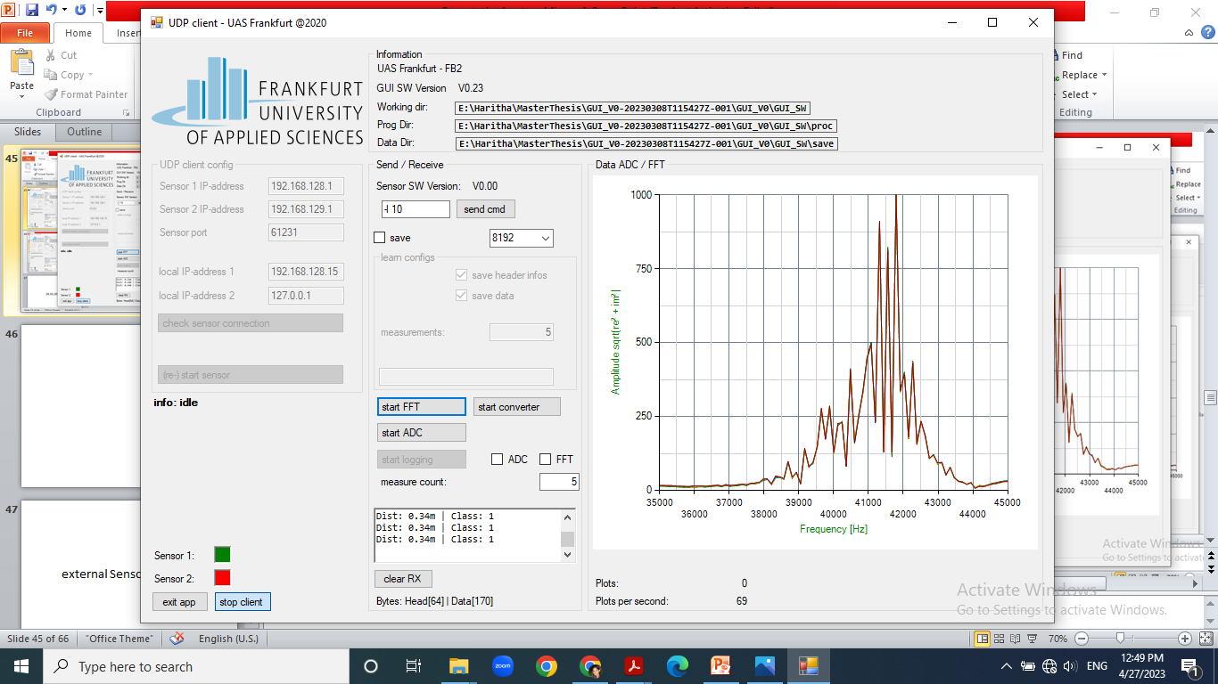
Notes:
empty

Slide 47
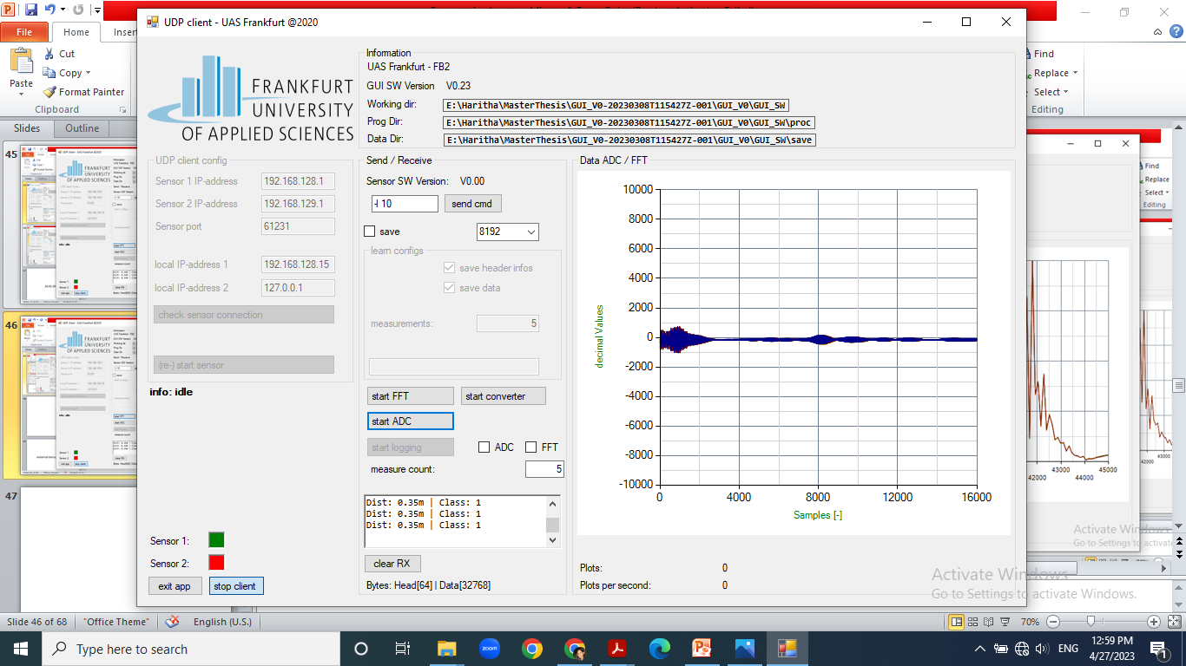
Notes:
baby

Slide 48
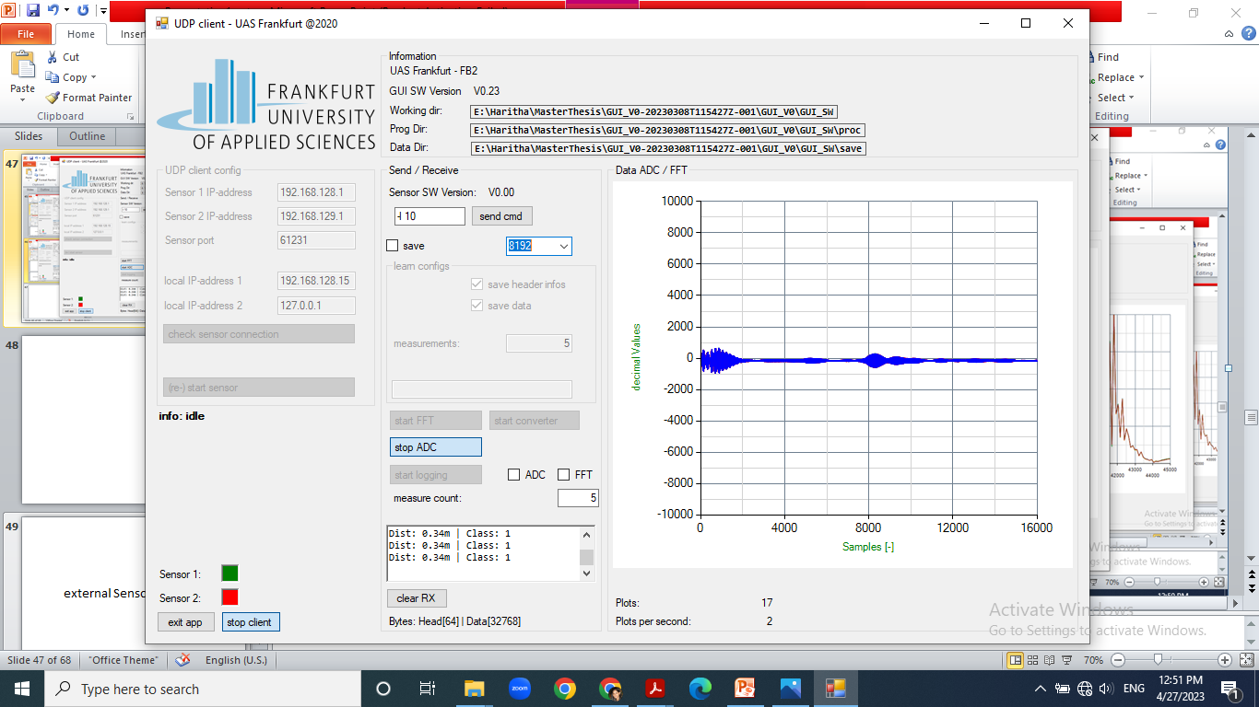
Notes:
empty

Slide 49
15.05.2023

Slide 50
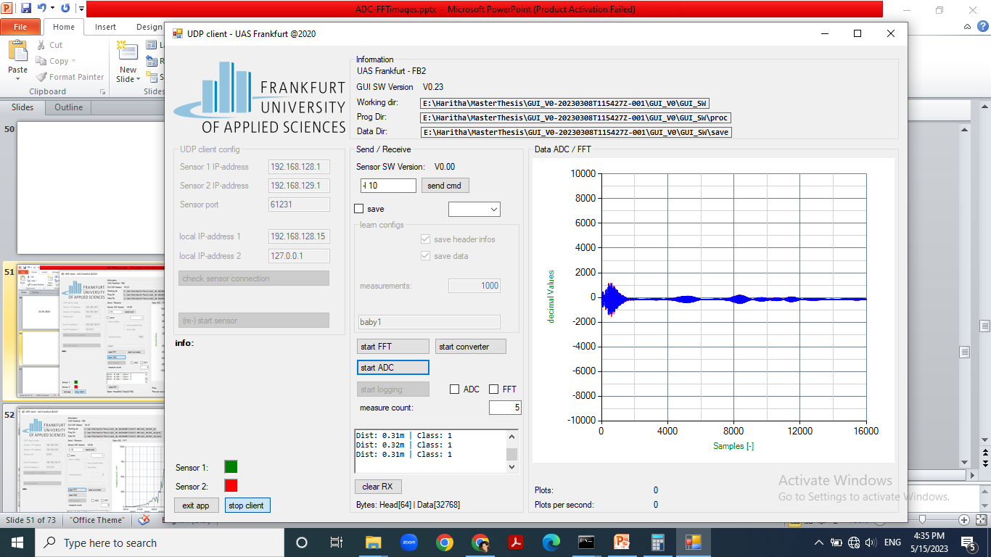
Notes:
empty

Slide 51
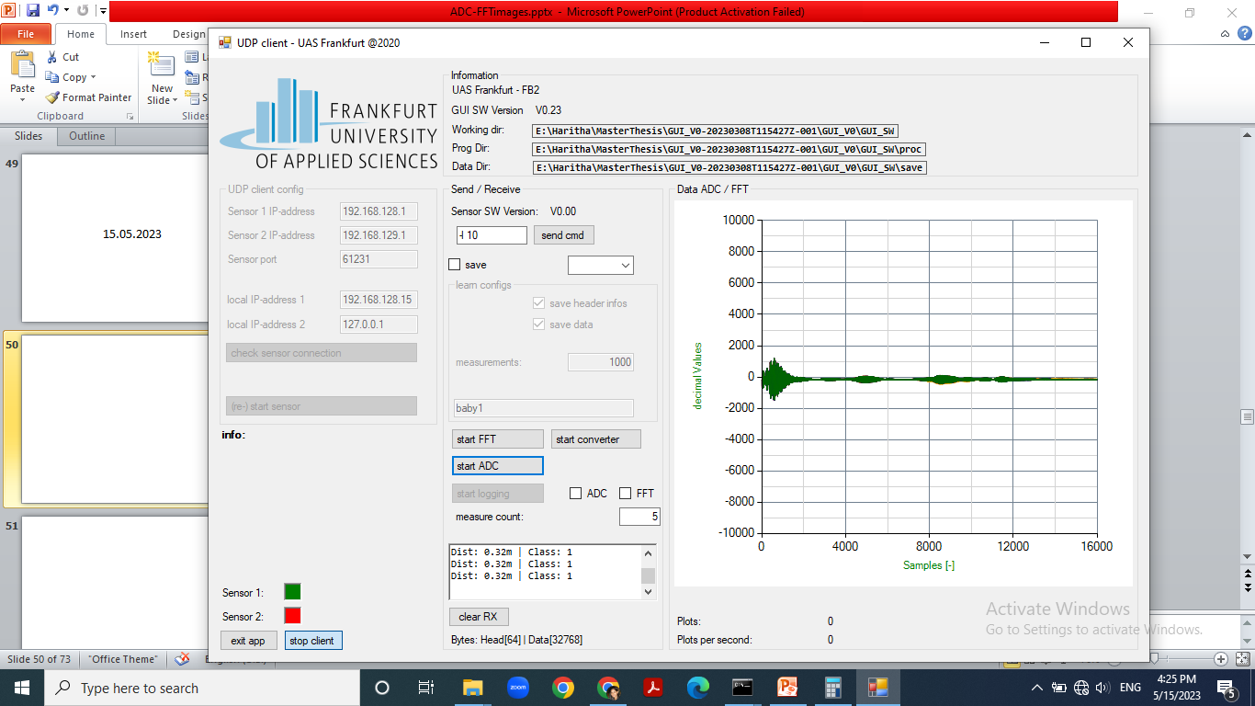
Notes:
baby

Slide 52
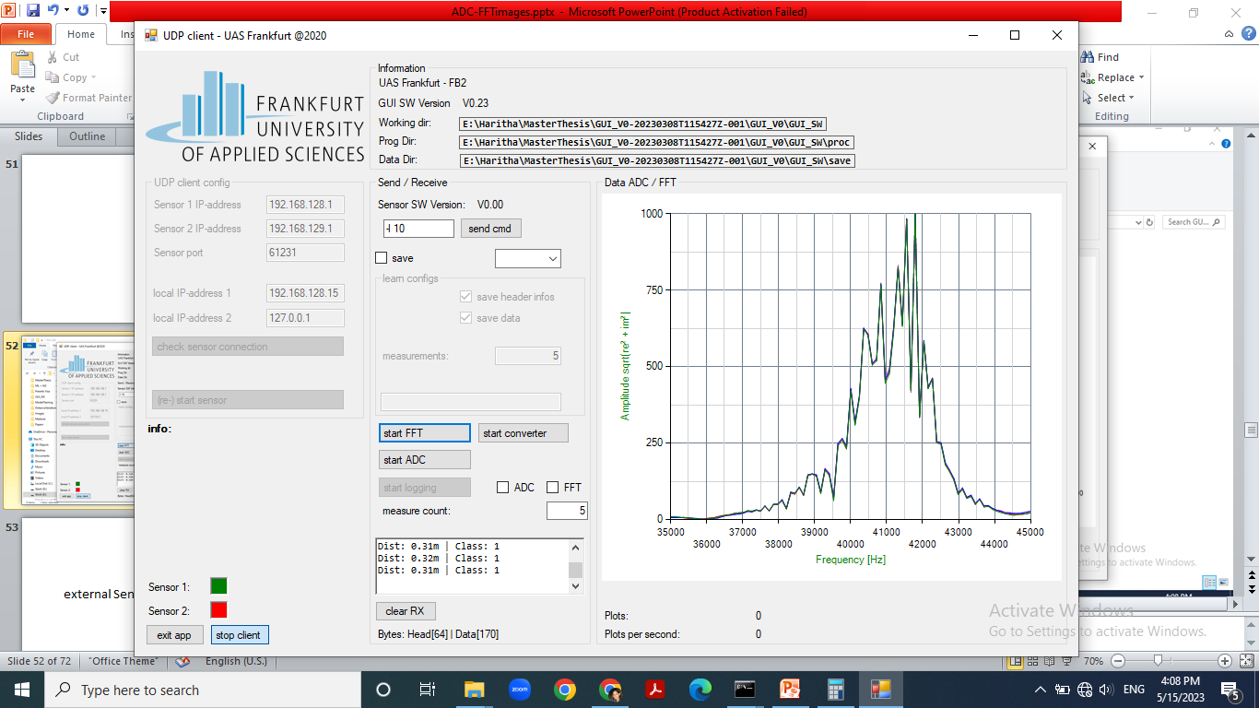
Notes:
empty

Slide 53
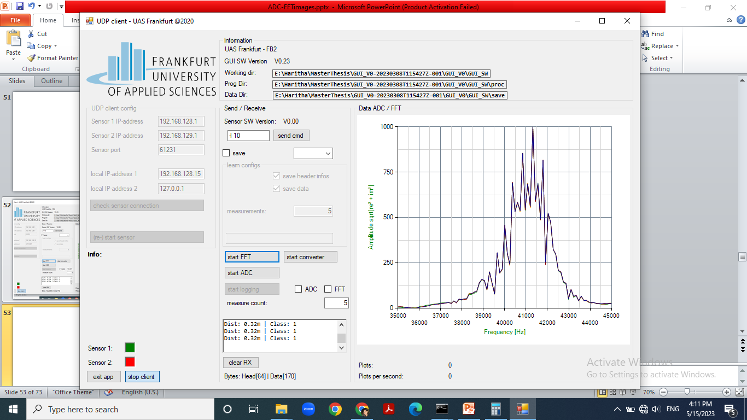
Notes:
baby

Slide 54
16.05.2023

Slide 55
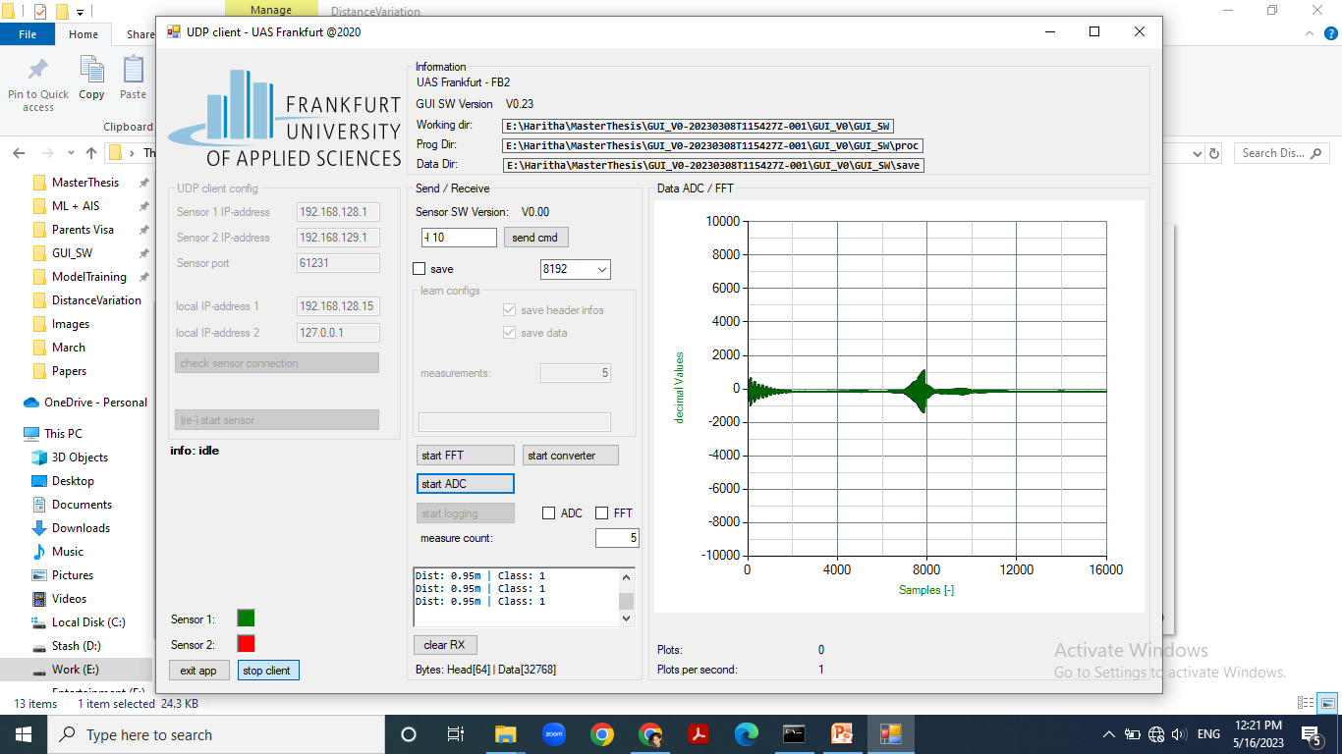
Notes:
Without infant carrier seat attached

Slide 56
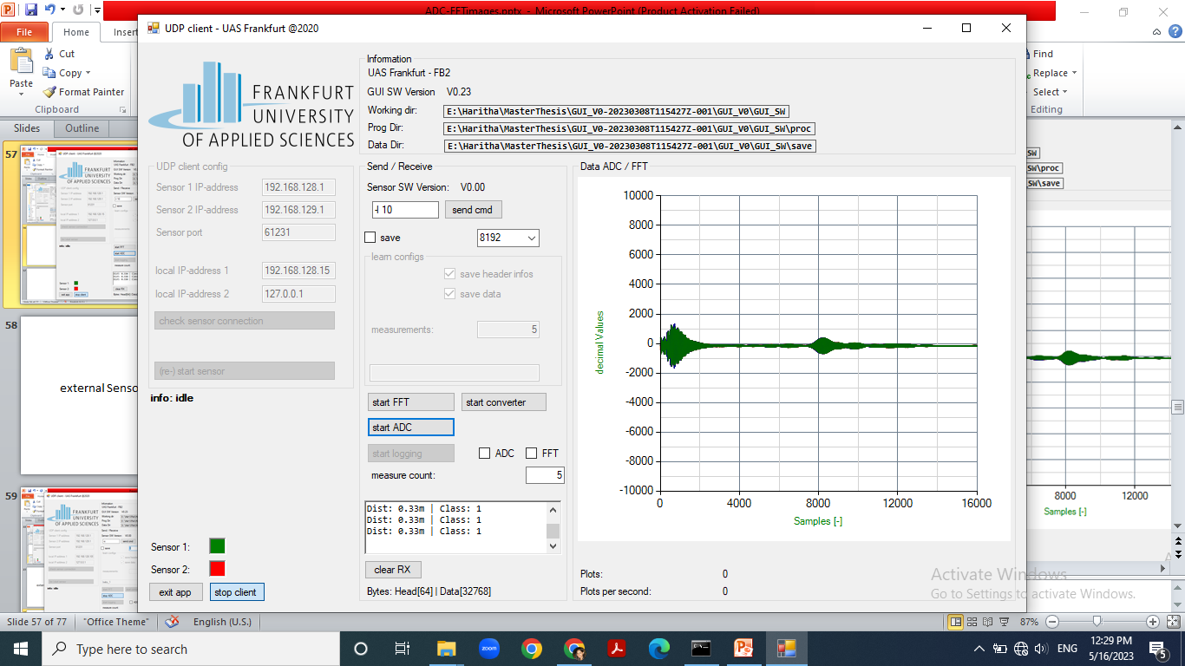
Notes:
empty

Slide 57
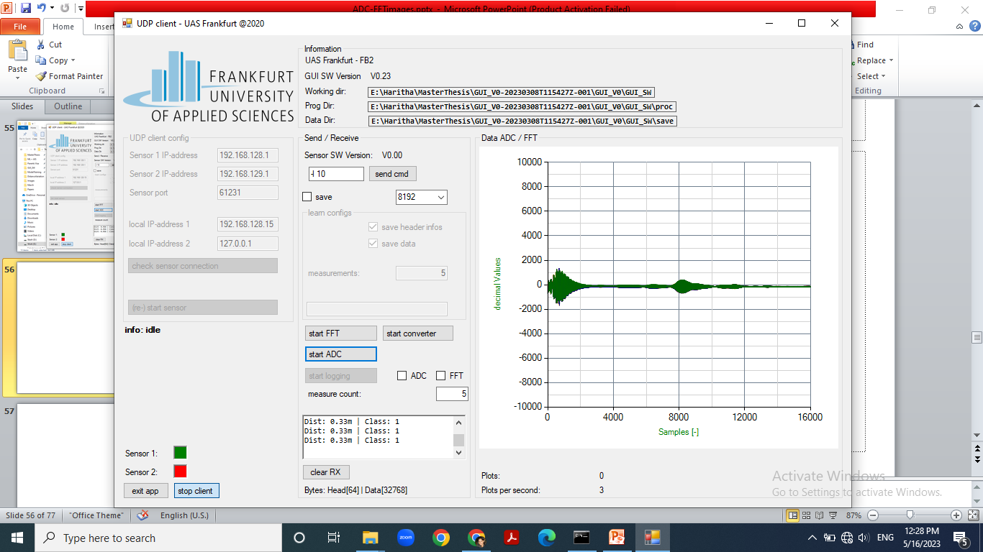
Notes:
Baby,

Slide 58
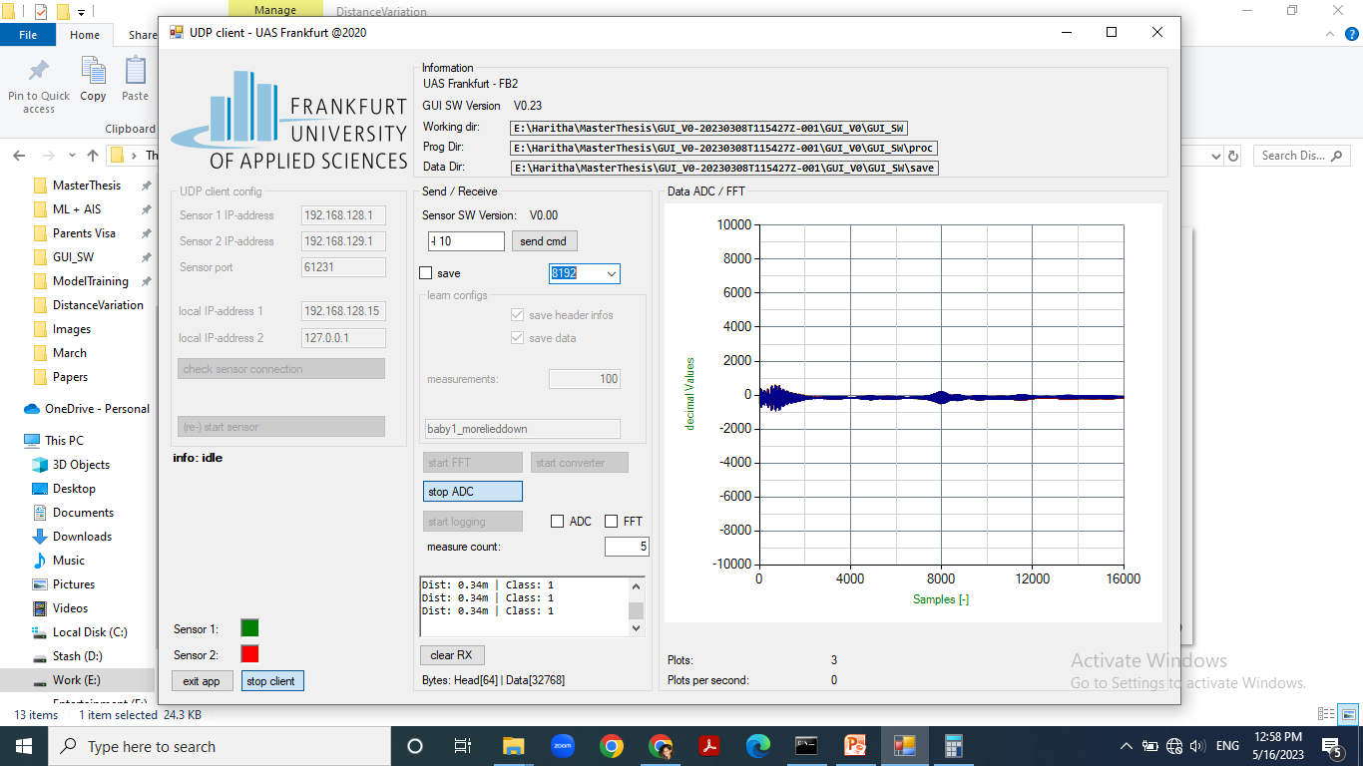
Notes:
baby1_morelieddown, check for anomalies and remove readings where distance = 0.97m or similar shape anomalies. Maybe run anomaly detection algorithm as first step to remove anomalies.

Slide 59
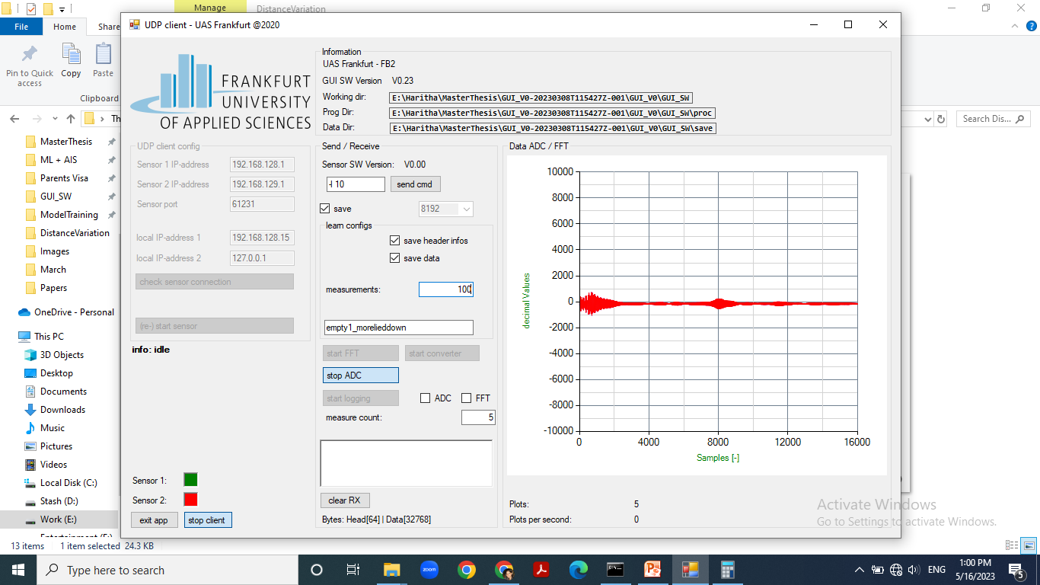
Notes:
Empty1_lieddown

Slide 60
19.05.2023

Slide 61
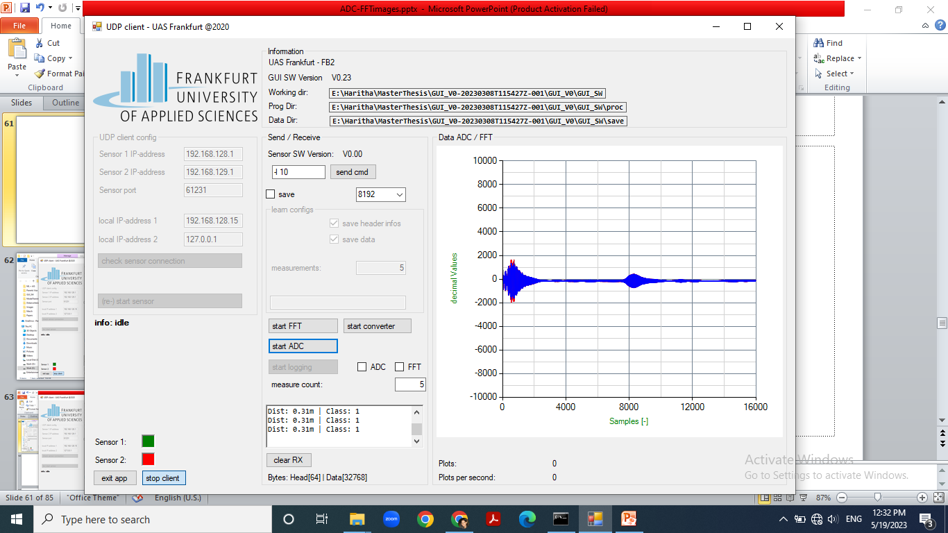
Notes:
Empty, wrong handle position

Slide 62
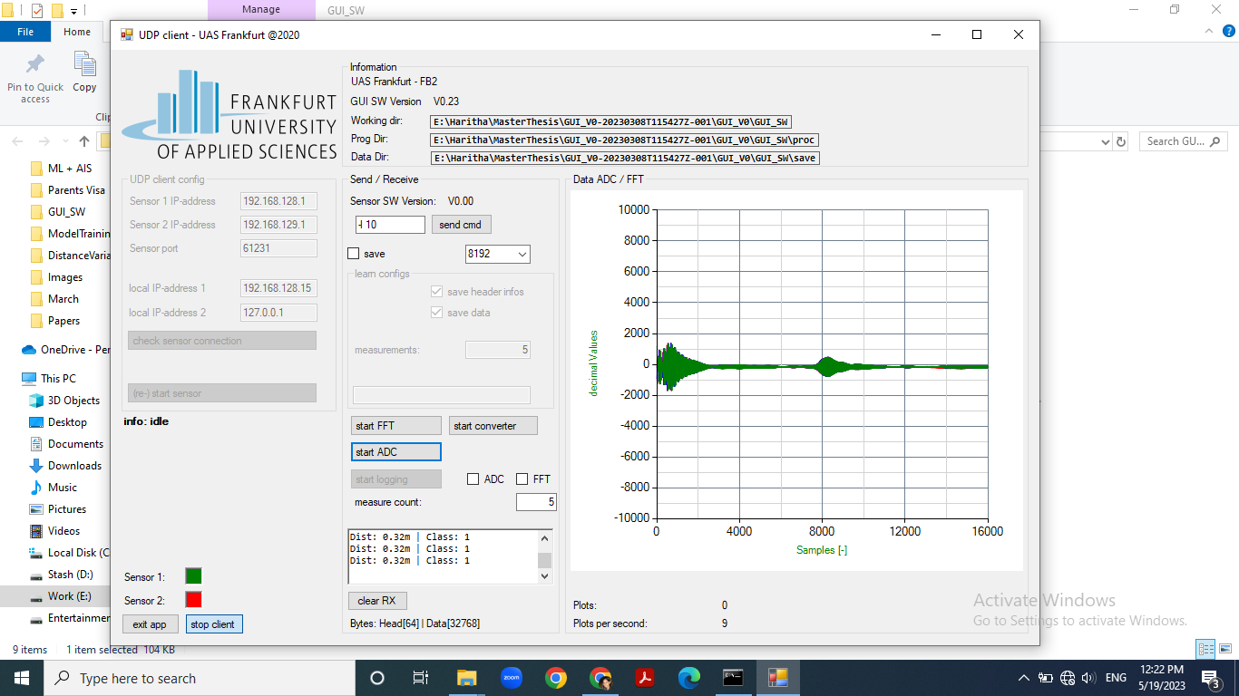
Notes:
With baby belted – head pushed upwards as much as possible

Slide 63
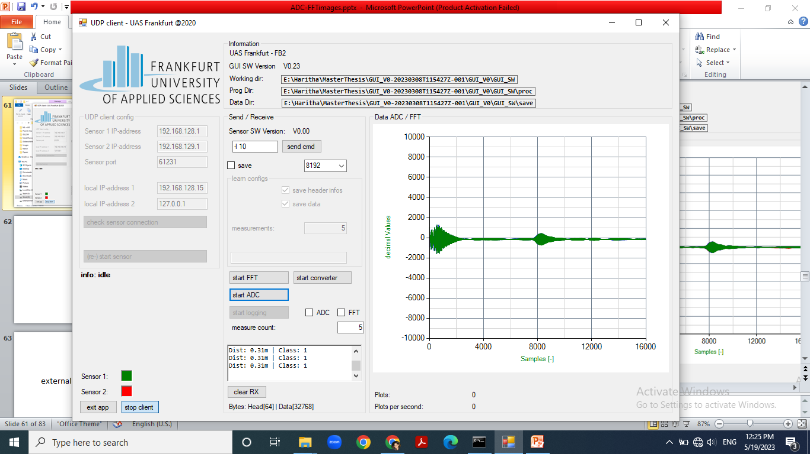
Notes:
With baby belted – feet pushed downwards as much as possible

Slide 64

Notes:
Baby_normal position, feet down, pushed down , but with handle lowered

Slide 65

Notes:
Baby_normal position, feet down, pushed down , but with handle in correct position

Slide 66

Notes:
Empty, handle in correct position

Slide 67

Notes:
Baby_normal position, feet down, pushed down , but with handle lowered

Slide 68

Notes:
Baby_normal position, feet down, pushed down , but with handle in correct position

Slide 69

Notes:
Empty, handle in correct position

Slide 70
23.05.2023

Slide 71

Notes:
Empty_leanedmiddleposition / (|/_)
Leanedmax ie horizontal position is the error readings recorded on this day, with distance = 1m

Slide 72

Notes:
Baby_leanedmiddleposition1. This position, I have the feeling, it wont give the best results.

Slide 73

Notes:
Empty leaned least , more in vertical position

Slide 74

Notes:
Baby leaned least , more in vertical position . In all these readings on this day it looks like the ratio of the 3rd peak to the 2nd and the 1st is going to be a deciding factor. See if it makes sense. All of the above readings were in the centre orientation

Slide 75

Notes:
Left oriened_empty_ leaned _least_vertical

Slide 76

Notes:
Left oriened_baby_ leaned _least_vertical

Slide 77

Notes:
right oriened_empty_ leaned _least_vertical

Slide 78

Notes:
Right oriened_baby_ leaned _least_vertical

Slide 79

Notes:
Empty _ sunshade open _ leaned middle _ left orient (ie toward sensor)

Slide 80


Slide 82
14.07.2023

Slide 83

Notes:
Baby, with handle in correct position

Slide 84

Notes:
Empty, Handle- correct position

Slide 85
external Sensor – RP 05

Slide 86

Notes:
Empty – first position

Slide 87

Notes:
Distance in adc not updated well roughly 0.33m

Slide 88


Slide 89


Slide 90


Slide 91


Slide 92

Notes:
Empty- last position

Slide 93

Notes:
baby

Slide 94

Notes:
With baby measurements, but seat distance comparison from shortest to farthest.

Slide 95


Slide 96


Slide 97


Slide 98


Slide 99


Slide 100
Comparison of with baby and without baby

Slide 101

Notes:
Empty,

Slide 102

Notes:
Baby head reflection profile

Slide 103
ERRORS

Slide 104

Notes:
Error screenshots / interference wierdly occurs more when door is closed, em interference? No, this is the output one gets when distance from object is less than 0.3 m or too close to the sensor, eg: When seat is in frontmost position.

Slide 105
First point of contact with empty infant carrier at 31-32 cm.
The cloth above baby’s head that is curved at 40.5 cm
Baby’s head at 46.5-47.5 cm. In complete laid up position, 50 cm

Slide 106
Measured on Data upto | Tested data _folder | Validation Accuracy | Validation Loss
Combinedadc upto half of 19.05.2023 | Testing_prev_19.05.2023 | 0.8843 | 0.3615 | Wrong handle position in infant carrier
Combinedadc upto half of 19.05.2023 | Testing2_prev_19.05.2023 | 0.9944 | 0.0235
Combinedadc upto half of 19.05.2023 | Testing3_prev_19.05.2023 | 0.7875 | 0.6378 | correcthandleposition
Combinedadc_upto 19.05.2023 | Testing_ 23.05.2023 | 0.5514 | 4.3233

